Slide 1
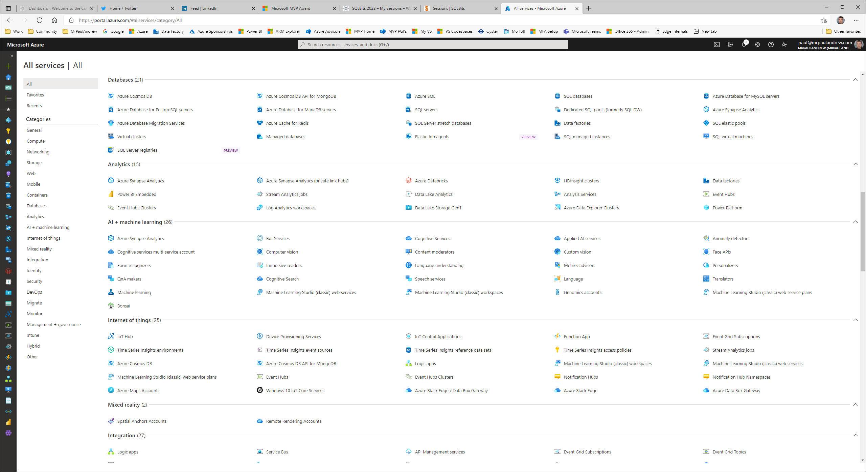
The Azure Icon Game
Can you name them all??

Slide 2
Azure Portal

Slide 3
Microsoft Azure

Slide 4

Users

Slide 5

SQL Database

Slide 6

SQL Logical Instance

Slide 7

PostgreSQL

Slide 8

MySQL

Slide 9

Virtual Machine

Slide 10

Cosmos DB

Slide 11

Azure Active Directory

Slide 12

Kubernetes

Slide 13

Blockchain

Slide 14

Resource Group

Slide 15

Virtual Network

Slide 16
Subnet

Slide 17

Network Interface

Slide 18
Front Door

Slide 19
Managed Private Link

Slide 20

Express Route

Slide 21
Network Security Group

Slide 22

Cognitive Services

Slide 23
HD Insight

Slide 24
Databricks

Slide 25

Synapse Analytics

Slide 26

Redis Cache

Slide 27

Machine Learning

Slide 28

Storage Account

Slide 29

Data Lake Store

Slide 30

Data Factory

Slide 31

Bot Services

Slide 32

Automation

Slide 33

Functions

Slide 34

Logic Apps

Slide 35

Analysis Services

Slide 36
Service Bus

Slide 37

Event Grid

Slide 38

Event Hub

Slide 39
IoT Hub

Slide 40

Stream Analytics

Slide 41

Power Platform

Slide 42

App Services

Slide 43
Log Analytics

Slide 44
Application Insights

Slide 45

Data Box

Slide 46
Data Share

Slide 47

Data Explorer

Slide 48

Key Vault

Slide 49
Management API

Slide 50
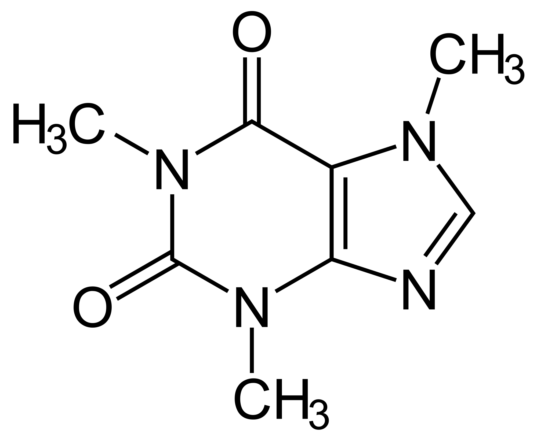
Caffeine

Slide 51
The Azure Icon Game – Thanks for playing!

Slide 52
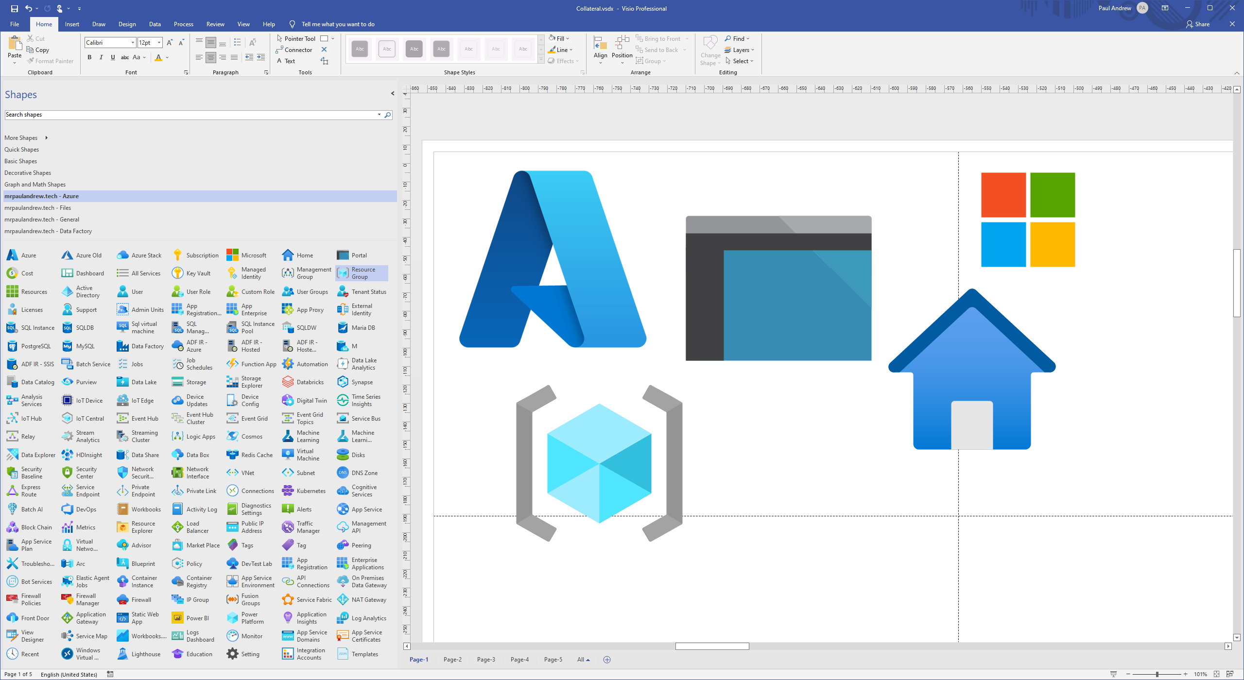

https://www.microsoft.com/en-gb/download/details.aspx?id=41937
https://github.com/mrpaulandrew/ContentCollateral

